Slide 1
PYTHON MODULE NUMPY
2022

Slide 2
Introduction to Numpy
NumPy created objects of ndarray.
NumPy is a Python library used for working with array.
It also has functions for working in domain of linear algebra, fourier transform, and matrices.
NumPy aims to provide an array object that is up to 50x faster than traditional Python lists.
NumPy is a Python library and is written partially in Python, but most of the parts that require fast computation are written in C or C++.
import numpy as np
module
alias

Slide 3

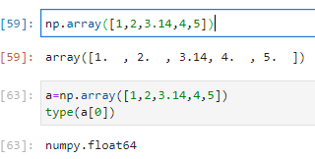


Creating array from python list
First, we can use np.array to create arrays from Python list:
np.array([1,2,3,4,5])
Remember that unlike Python lists, NumPy is constrained to arrays that all contain the same type. If types do not match, NumPy will upcast if possible:
np.array([1,2,3,3.14,4,5])
np.array([1,2,3,3.14,4,5])
type(a[0])
If we want to explicitly set the data type of the resulting array, we can use the dtype keyword:
np.array([1,2,3,4,5]), dtype = float)
The inner lists are treated as rows of the resulting two-dimensional array.
np.array([[1,2,3],[2,3,4]])

Slide 4

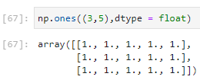
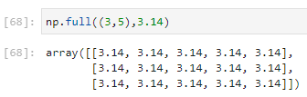


Creating array from NumPy functions:
Create a length-10 integer array filled with np.zeros
Create a 3x5 floating-point array filled with 1s
np.zeros([10, dtype = int)
np.ones((3,5), dtype = float)
Create a 3x5 array filled with 3.14
np.full((3,5), 3.14)
Create an array filled with a linear sequence. Starting at 0, ending at 20, stepping by 2.
np.arange(0,20,2)
Create an array of five values evenly spaced between 1 and 2
np.linspace(1,2,6)

Slide 5
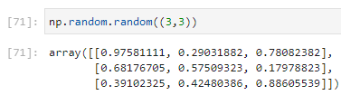
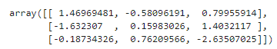
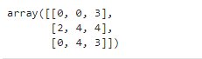
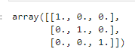
Create a 3x3 array of uniformly distributed. Random values between 0 and 1.
np.random.random((3,3))
Create a 3x3 array of normally distributed random values with mean 0 and standard deviation 1.
np.random.normal(0,1,(3,3))
Create a 3x3 array of random integers in the interval [0, 10]
np.random.randint(0,10,(3,3))
Create a 3x3 identity matrix
np.eye(3)

Slide 6
NumPy standard data types
Data type | Description
bool_ | Boolean (True of False) stored as a byte
int_ | Default integer type (as C long)
intc | Identical used to C int
intp | Integer used for indexing
int8 | Byte(-128 to 127)
int16 | Integer(-32768 to 32767
int32 | Integer (–2147483648 to 2147483647)
int64 | Integer (–9223372036854775808 to 9223372036854775807)
uint8 | Unsigned integer (0 to 255)
uint16 | Unsigned integer (0 to 65535)
uint32 | Unsigned integer (0 to 4294967295)
uint64 | Unsigned integer (0 to 18446744073709551615)
float_ | Shorthand for float64
float16 | Half-precision float: sign bit, 5 bits exponent, 10 bits mantisa

Slide 7
Data Type | Description
float32 | Single-precision float: sign bit, 8 bits exponent, 23 bits mantisa
float64 | Double-precision float: sign bit, 11 bits exponent, 52 bits mantisa
complex_ | Shorthand for complex128
Complex64 | Complex number, represented by two 32-bit floats
Complex128 | Complex number, represented by two 64-bit floats

Slide 8
The basics of NumPy arrays
Few categories of basic array manipulations:
Attributes of arrays: Determining the size, shape, memory consumption, and data types of arrays.
Indexing of arrays: Getting and setting the value of individual array elements.
Slicing of arrays: Getting and setting smaller subarrays within a larger array.
Reshaping of arrays: Changing the shape of a given array.
Joining and splitting of arrays: Combining multiple arrays into one, and splitting one array into many.

Slide 9
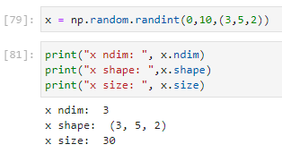


NumPy Array Attributes
Determining the shape, size and dimension of array.
x = np.random.normal(0,10,(3,5,2))
print(“x ndim: ”, x.ndim)
print(“x shape: ”, x.shape)
print(“x size: ”, x.size)
Another useful attribute is the dtype, the data type of the array.
print(“x dtype: ”, x.dtype)
Other attributes include itemsize, which lists the size (in bytes) of each array element, and nbytes, which lists the total size (in bytes) of the array:
print(“x itemsizer: ”, x.itemsizer, “bytes”)
print(“x ntypes: ”, x.ntypes, “bytes”)

Slide 10
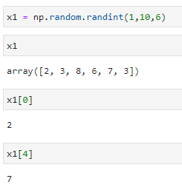
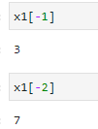
Array Indexing: Accessing Single Elements
In a one-dimensional array, you can access the i^{th} value (counting from zero) by specifying the desired index in square brackets, just as with Python lists:
x1 = np.random.randint(1,10,6)
x1
x1[0]
x1[4]
To index from the end of the array, you can use negative indices:
x1[-1]
x1[-2]

Slide 11
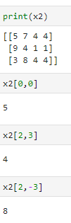
In a multidimensional array, you access items using a comma-separated tuple of Indices:
print(x2)
x2[0,0]
x2[2,3]
x2[2,-3]

Slide 12
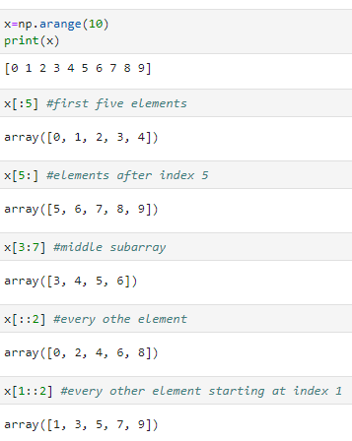
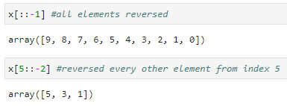
Array Slicing: Accessing Subarrays
Just as we can use square brackets to access individual array elements, we can also use them to access subarrays with the slice notation, marked by the colon (:) character. The NumPy slicing syntax follows that of the standard Python list; to access a slice of an array x, use this: x[start : stop : step]
If any of these are unspecified, they default to the values start=0, stop=size of dimension, step=1.
One-dimensional subarrays
x = np.arrange(10)
print(x2)
A potentially confusing case is when the step value is negative. In this case, the defaults for start and stop are swapped. This becomes a convenient way to reverse an array:
x[ : 5] #first five elements
x[ : : -1] #all element reversed
x[5 : ] #elements after index 5
x[5 : : -2] #reversed every other element starting at index 5
x[3 : 2] #middle subarray
x[ : : 2] #every other element
x[1 : : 2] #every other element starting at index 1

Slide 13
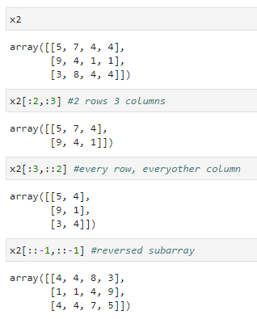
Multidimensional subarrays
Multidimensional slices work in the same way, with multiple slices separated by commas. For example:
x2
x2[ : 2 , : 3] #2 rows 3 columns
x2[ : 3 , : : 2] #every row, everyother column
x2[ : : -1 , : : -1] #reversed subarray

Slide 14
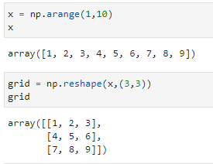
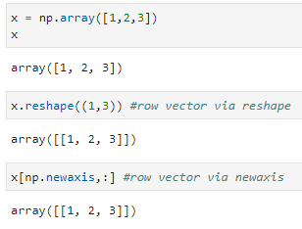
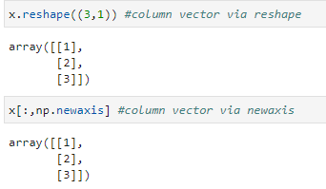
Reshaping of Arrays
Another useful type of operation is reshaping of arrays. The most flexible way of doing this is with the reshape() method. For example, if you want to put the numbers 1 through 9 in a 3×3 grid, you can do the following:
x = np.arrange(1, 10)
x
grid = np.reshape(x, (3, 3))
grid
Another common reshaping pattern is the conversion of a one-dimensional array into a two-dimensional row or column matrix. You can do this with the reshape method, or more easily by making use of the newaxis keyword within a slice operation:
x = np.array([1, 2 , 3])
x
x.reshape((3, 1)) #column vector via reshape
x.reshape((1, 3)) #row vector via reshape
x[ : , np.newaxis] #column vector via newaxis
x[np.newaxis, :] #row vector via newaxis

Slide 15
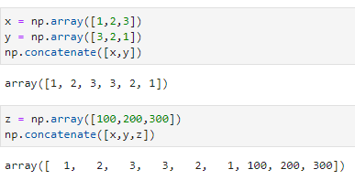
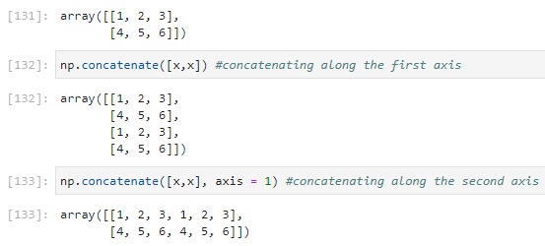
Array Concatenation and Splitting
All of the preceding routines worked on single arrays. It’s also possible to combine multiple arrays into one, and to conversely split a single array into multiple arrays.
Concatenation of arrays
Concatenation, or joining of two arrays in NumPy, is primarily accomplished through the routines np.concatenate, np.vstack, and np.hstack. np.concatenate takes a tuple or list of arrays as its first argument.
x = np.array([1, 2 , 3])
y = np.array([3, 2 , 1])
np.concatenate([x, y])
z = np.array([100, 200 , 300])
np.concatenate([x, y,z])
np.concatenate can also be used for two-dimensional arrays:
np.concatenate([x, x]) #concatenating along the first axis
np.concatenate([x, x], axis = 1) #concatenating along the second axis

Slide 16
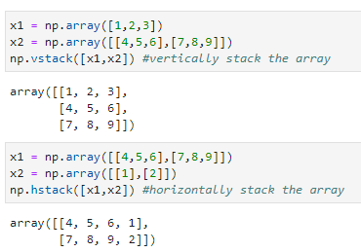

For working with arrays of mixed dimensions, it can be clearer to use the np.vstack (vertical stack) and np.hstack (horizontal stack) functions:
x1 = np.array([1, 2 , 3])
x2 = np.array([[4, 5, 6], [7, 8, 9]])
np.vstack([x1, x2]) #vertically stack the array
x1 = np.array([[4, 5, 6], [7, 8, 9]])
x2 = np.array([[1], [2]])
np.hstack([x1, x2]) #horizontally stack the array
Similarly, np.dstack will stack arrays along the third axis
Splitting of arrays
The opposite of concatenation is splitting, which is implemented by the functions np.split, np.hsplit, and np.vsplit. For each of these, we can pass a list of indices giving the split points:
x = [1, 2, 3, 99, 99, 3, 2 , 1]
x1, x2, x3 = np.split(x, [2,4])
print(x1, x2, x3)

Slide 17
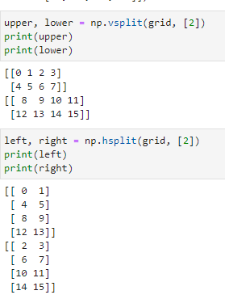
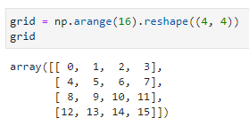
The related functions np.hsplit and np.vsplit are similar:
upper, lower = np.vsplit(grid, [2])
print(upper)
print(lower)
grid = np.arange(16).reshape(x, (3, 3))
grid
left, right = np.hsplit(grid, [2])
print(left)
print(right)
Similarly, np.dsplit will split arrays along the third axis.

Slide 18
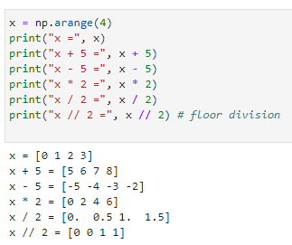

NumPy’s UFuncs
Ufuncs exist in two flavors: unary ufuncs, which operate on a single input, and binary ufuncs, which operate on two inputs.
Array arithmetic
NumPy’s ufuncs feel very natural to use because they make use of Python’s native arithmetic operators.
x = np.arange(4)
print(“x = ”, x)
print(“x + 5 = ”, x + 5)
print(“x - 5 = ”, x - 5)
print(“x * 2 = ”, x * 2)
print(“x / 2 = ”, x / 2)
print(“x // 2 = ”, x // 2) # floor divison
Operator | Equivalent ufunc
+ | np.add
- | np.substract
- | np.negative
* | np.multiply
/ | np.divide
// | np.floor_divide
** | np.power
% | np.mood
Example:
-(0.5 * x + 1) ** 2

Slide 19
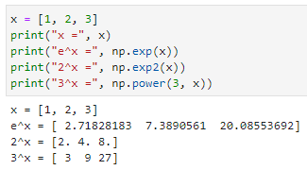
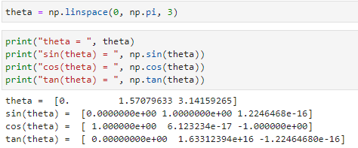
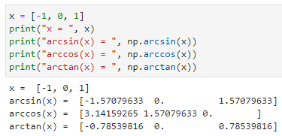
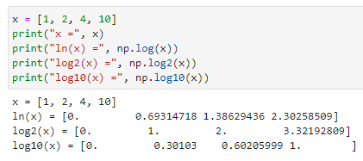
Trigonometric functions
NumPy provides a large number of useful ufuncs, and some of the most useful for the data scientist are the trigonometric functions.
Exponents and logarithms
x = [1, 2, 3]
print(“x = ”, x)
print(“e^x = ”, np.exp(x))
print(“2^x = ”, np.exp2(x))
print(“3^x = ”, np.power(3, x))
theta = np.linspace(0, np.pi, 3)
print(“theta = ”, theta)
print(“sin(theta) = ”, np.sin(theta))
print(“cos(theta) = ”, np.cos(theta))
print(“tan(theta) = ”, np.tan(theta))
The basic np.log gives the natural logarithm; if you prefer to compute the base-2 logarithm or the base-10 logarithm, these are available as well:
Inverse Trigonometric functions
x = [-1, 0, 1]
print(“x = ”, x)
print(“arcsin(x) = ”, np.arcsin(x))
print(“arccos(x) = ”, np.arccos(x))
print(“arctan(x) = ”, np.arctan(x))
x = [1, 2, 4 , 10]
print(“x = ”, x)
print(“ln(x) = ”, np.log(x))
print(“log2(x) = ”, np.log2(x))
print(“log10(x) = ”, np.log10(x))

Slide 20
Aggregation functions available in NumPy
Function Name | NaN-safe Version | Description
np.sum | np.nansum | Compute sum of elements
np.prod | np.nanprod | Compute product of elements
np.mean | np.nanmean | Compute median of elements
np.std | np.nanstd | Compute standard deviation
np.var | np.nanvar | Compute variance
np.min | np.nanmin | Find minimum value
np.max | np.nanmax | Find maximum value
np.argmin | np.nanargmin | Find index of minimum value
np.argmax | np.nanargmax | Find index of maximum value
np.median | np.nanmedian | Compute median of elements
np.percentile | np.nanpercentile | Compute rank-based statistics of elements
np.any | N/A | Evaluate whether any elements are true
np.all | N/A | Evaluate whether all elements are true

Slide 21
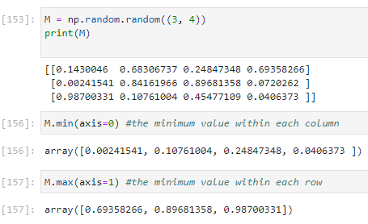
Aggregations: Min, Max, and Everything in Between
Python has built-in min and max functions, used to find the minimum value and maximum value of any given array:
M = np.random.random((3, 4))
print(M)
M.min(axis = 0) #minimum value within each column
M.max(axis = 1) #maximum value within each row

Slide 22
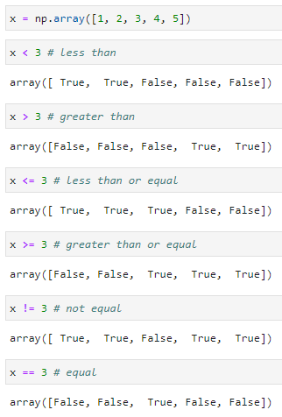
Comparison Operators as ufuncs
. NumPy also implements comparison operators such as < (less than) and > (greater than) as element-wise ufuncs. The result of these comparison operators is always an array with a Boolean data type.
x = np.array([1, 2, 3, 4, 5]) #maximum value within each row
x < 3 # less than
Operator | Equivalent ufunc
== | np.equal
!= | np.not_equal
< | np.less
<= | np.less_equal
> | np.greater
>= | np.greater_equal
x > 3 # greater than
x <= 3 # less than or equal
x >= 3 # greater than or equal
x != 3 # not equal
Just as in the case of arithmetic ufuncs, these will work on arrays of any size and shape.
x == 3 # equal

Slide 23
Fancy Indexing
Fancy indexing is like the simple indexing we’ve already seen, but we pass arrays of indices in place of single scalars. This allows us to very quickly access and modify complicated subsets of an array’s values.
Fancy indexing is conceptually simple: it means passing an array of indices to access multiple array elements at once.
import numpy as np
rand = np.random.RandomState(42)
x = rand.randint(100, size=10)
print(x)
Suppose we want to access three different elements. We could do it like this:
[x[3], x[7], x[2]]
Alternatively, we can pass a single list or array of indices to obtain the same result
ind = [3, 7, 4]
x[ind]

Slide 24



With fancy indexing, the shape of the result reflects the shape of the index arrays rather than the shape of the array being indexed:
ind = np.array([[3, 7], [4, 5]])
x[ind]
Fancy indexing also works in multiple dimensions.
X = np.arange(12).reshape((3, 4))
X
Like with standard indexing, the first index refers to the row, and the second to the column:
row = np.array([0, 1, 2])
col = np.array([2, 1, 3])
X[row, col]
Notice that the first value in the result is X[0, 2], the second is X[1, 1], and the third is X[2, 3].

Slide 25


Combined Indexing
For even more powerful operations, fancy indexing can be combined with the other indexing schemes:
print(X)
We can combine fancy and simple indices:
X[2, [2, 0, 1]
We can also combine fancy indexing with slicing:
X[1 : , [2, 0, 1]

